Slide 1
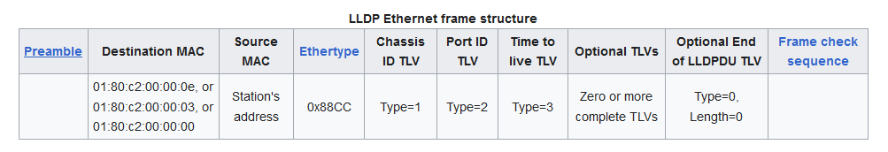
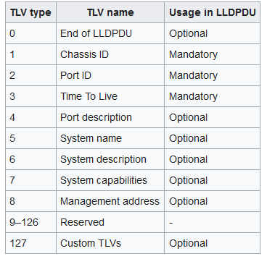
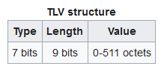
USE CASE:
Inclusion of standard discovery protocol information @NEs for topology auto-discovery, complementing information such as MAC FWD table info, or any other available on MNO systems.
LLDP (IEEE 802.1ab standard):
Discovery of Ethernet link connections
Widespread general support in MW equipment (recent and some previous HW models). Also supported in IP equipment
Taken as base discovery protocol in other SDOs for topology use cases (ETSI mWT profiles, TIP)
Mandatory & optional TLVs (type-lenght-value fields) + Custom organization specific TLVs (e.g. 802.1, 802.3…)
Configurable behavior at node/port level
TLV types
0x0180-C200-000E for LLDP frames destined for nearest bridge agents.
0x0180-C200-0000 for LLDP frames destined for nearest customer bridge agents.
0x0180-C200-0003 for LLDP frames destined for nearest non-TPMR bridge agents
Data+pad 1500bytes
*custom TLVs have a different field structure

Slide 2
KEY TLVS FOR DISCOVERY (std. MANDATORY TLVs) → chassis ID & port ID
CHASSIS ID – identifies the node associated with the transmitting LLDP agent
Subtype identifies the type of component referenced by the ID field
chassis component
interface alias
port component
MAC address
Network address
interface name
locally assigned
PORT ID – identifies the port component associated with the transmitting LLDP agent. Each LLDP PDU can only include one Port ID TLV, which needs to be constant during operation
Subtype identifies the type of component referenced by the ID field
interface alias
port component
MAC address
Network address
interface name
agent circuit ID
locally assigned
Other TLVs can extend the info and might be interesting as optional → system description / capabilities, management address, …
Some TLVs might be managed differently in different implementations (e.g., different CHASSIS / PORT ID subtypes)

Slide 3
A
Tx chassisID_A
+ portID_A_PA1
Rx chassisID _B
+ portID_B_PB1
BASE TLVS:
Vendors consulted: Siae, Huawei, Ericsson, Nokia, ZTE, NEC (others also with known support)
Mandatory TLVs supported by all vendors in different HW platforms
Different subtypes in Chassis/Port ID mandatory TLVs
Wide support of optional TLVs, differential implementation as well in some of them
NE: A
Port: PA1
Tx: chassisID_A + Port ID_A_PA1
Rx: chassisID_B + PortID_B_PB1
B
Controller
NE: B
Port: PB1
Tx: chassisID_B + Port ID_B_PB1
Rx: chassisID_A + PortID_A_PA1
Link discovery
A
B

Slide 4
ORGANIZATIONALLY SPECIFIC TLVs
Vendors consulted: Siae, Huawei, Ericsson, Nokia, ZTE, NEC
Organizationally specific TLVs with partial support, and only for a subset of the standardized ones
Some vendors open to implement if needed

Slide 5
Some protocol LLDP PDU trx/rx relevant parameters and defaults
adminStatus → controls interface activation: enabledTxOnly / enabledRxOnly / enabledRxTx / disable
msgTxInterval → interval (timer ticks/seconds) between tx cycles in normal mode. Default 30s, range 1-3600.
msgTxHold → multiplies msgTxInterval to set the TTL. Default 4, range 1-100.
msgFastTx→ interval (timer ticks/seconds) between tx cycles in fast mode. Default 1s, range 1-3600.
txFastInit → number of PDUs that can be transmitted in a fast period. Default 4, range 1-8.
reinitDelay → delay after adminStatus gets disabled before re-init is attempted. Default 2s.
txCreditMax → max. consecutive PDUs that can be transmitted. Default 5, range 1-10
remoteChanges – indicates status/value of remote objects in the LLPD MIB have changed
TooManyNeighbors – indicates insufficient space in the remote LLDP to store info from all neighbors

Slide 6
Options to include LLDP support in TR-532
Air interfaces (Status) include localEndpointId and remoteEndpointId, which can be used to store a concatenation of LLDP chassis_ID + port ID
Fields not currently supported in all implementations
Does not allow for management of LLDP configuration
Similar fields do not exist in Wire Interfaces
Would only enable PoC validation of apps using LLDP info and interoperability
Preferred option would be to implement a solution that enables the management of LLDP
LLDP support in current MW HW in principle should not be a problem
LLDP detailed management and parameter availability per vendor
Existing models, e.g.:
IEEE: https://1.ieee802.org/tsn/802-1abcu/
Openconfig: http://ops.openconfig.net/branches/models/master/docs/openconfig-lldp.html
Proposal…
Adopt from existing IEEE model, adapting to TR-512/532 model structure
CHECK WHETHER a mínimum implementaiton to enable discovery in 2.0 is feasible, then complete / update in 2.1 to minimize impact on 2.0 timeline
Chassis & port mandatory fields (Chassis ID, Port ID)
Per-port LLDP activation & de-activation fields
Other chassis/port parameters that might be mandatory for basic operation and discovery (e.g protocol timers, dest-MAC-address?...)
Define how to augment→ all @CC (simple retrieval) or @CC + interfaces (ETH container)
A
Tx chassisID_A
+ portID_A_PA1
Rx chassisID _B
+ portID_B_PB1
NE: A
Port: PA1
Tx: chassisID_A + Port ID_A_PA1
Rx: chassisID_B + PortID_B_PB1
B
Controller
NE: B
Port: PB1
Tx: chassisID_B + Port ID_B_PB1
Rx: chassisID_A + PortID_A_PA1
Link discovery
A
B

Slide 7
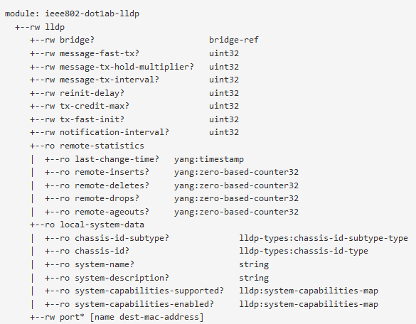
https://yangcatalog.org/api/services/tree/ieee802-dot1ab-lldp@2018-11-11.yang
To use as a general reference, not totally up-to-date (Nov-2018)
However, only minor changes in more recent 802.1ABcu Jun-2021 D2.0, so, valid for discussion
P
Per lldp agent (@CC) protocol general config→ Devices with >1 agent?
Generally, would it be possible to interwork without these (all/any) using just protocol defaults @ agent level? If so, R/W params not strictly needed in v2.0
IS TTL configuration needed? in that case R/W tx-hold & tx-interval would be needed
Agent/protocol general config
Counters/stats
Mandatory for 2.0
Minimum for 2.0
Chassis-id R string, subtype R enum not strictly needed, but probably better to have
Subtype enum: chassis component(1), interface alias (2), port component (3), MAC address(4), Network address (5), interface name (6), locally assigned (7), 0 & 8-255 reserved
Local chassis / agent data – transmit (non-config)
…
SECURITY constraints required by many Obs→ non-continuous operation of the discovery protocol, and never in customer facing ports
*protocol activation & de-activation needed (only@ port or also @ agent/chassis level?)

Slide 8
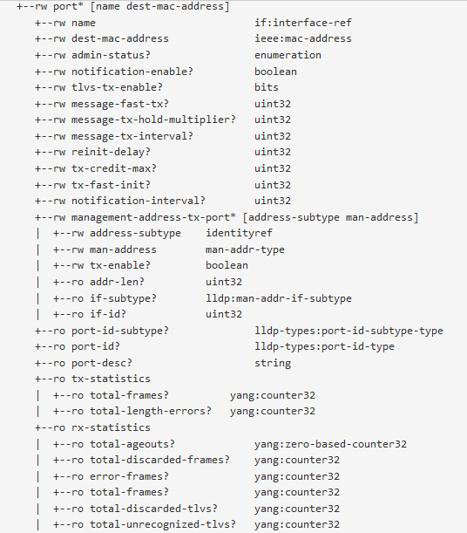
…
List key fields name (pointer to LTP) & dest-mac-address +
Per-port activation R/W → TX(1) / RX(2) / TX+RX(3) / Disable (4)
Minimum for 2.0
DEST-MAC-ADDRESS: Confirm interworking possible using nearest bridge 01-80-C2-00-00-0E by default. If so, not needed as configurable param in v2.0.
If needed, then R/W enum 01-80-C2-00-00-0E (nearest), 01-80-C2-00-00-03 (nearest non TMPR), 01-80-C2-00-00-00 (nearest customer bridge)
Per-port protocol general info & config – transmit
Generally, would it be possible to interwork without these (all/any) using just protocol defaults and just enabling mandatory TLVs (or mandatory+optional). If so, not strictly needed in v2.0
IS TTL configuration needed? in that case tx-hold & tx-interval would be needed
Mgmnt.address
Trx TLV
Confirm it is possible to work without advertising mgmt. address TLV. If so, not strictly needed in v2.0
Minimum for 2.0
Port-id R string, subtype R enum not strictly needed, but probably better to have
Subtype enum: interface alias (1), port component (2),, MAC address (3), Network address (4), interface name (5), agent circuit ID (6), locally assigned (7), 0 & 8-255 reserved
Port statistics
TX&RX
…

Slide 9
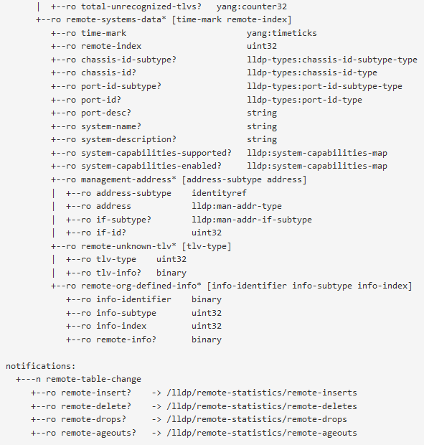
…
Remote port received info
List key fields (R)
Chassis-id R string, subtype R enum not strictly needed, but probably better to have
Subtype enum: chassis component(1), interface alias (2), port component (3), MAC address(4), Network address (5), interface name (6), locally assigned (7), 0 & 8-255 reserved
Port-id R string, subtype R enum not strictly needed, but probably better to have
Subtype enum: interface alias (1), port component (2),, MAC address (3), Network address (4), interface name (5), agent circuit ID (6), locally assigned (7), 0 & 8-255 reserved
Minimum for 2.0
Mgmnt.address
-- received
Confirm it is possible to work without advertising mgmt. address TLV. If so, not strictly needed in v2.0
Remote port received info
remoteChanges & TooManyNeighbors included in 802.1ABcu Jun-2021 D2.0
Discuss if they would be needed in v2.0 for correct protocol operation
Notifications

